Slide 1
Exploring Coordinated Attacks of Federated Learning TinyML Protected IoT Systems
Raine Morrigan
Dr. Hasan
June 9, 2025

Slide 2
This project attempts to show remaining vulnerabilities in IOT systems trained with State-Of-Art Federated Learning TinyMLs
Enhancing your presentation

Slide 3
Background and Previous Experience
Intro to Statistical Learning
Ethical Hacking
Software Security
Intro to AI

Slide 4
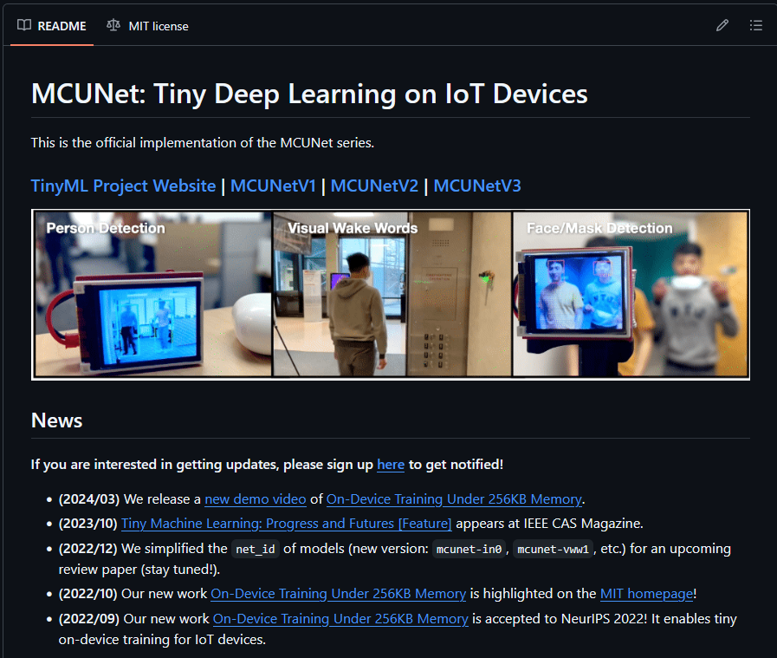
AI Methods
https://github.com/mit-han-lab/tinyml
Tiny Machine Learning (TinyML) is a field of machine learning that focuses on running models on resource-constrained devices like microcontrollers, ultra-low-power devices, and other IoT devices

Slide 5
Initial Setup & Current Challenges
Arduino IDE
Setup Troubleshooting
Researching Attack Strategies
Confirming a testbed
Currently, I have not been able to successfully connect the ESP32-Cam to my IDE, but I have made plans to get help next week from people that have Arduino experience.

Slide 6

Next Steps
Flash ESP32-Cam
Connect Arduino and ESP32-Cam
Recreate TinyML
Determine dataset for Facial Recognition

Slide 7
References
https://github.com/mit-han-lab/mcunet
X. Sheng, Z. Yang and W. Bao, "FairGuard: A Fairness Attack and Defense Framework in Federated Learning," in IEEE Transactions on Dependable and Secure Computing, vol. 22, no. 3, pp. 2519-2532, May-June 2025
K. Naveen Kumar, C. Krishna Mohan and L. Reddy Cenkeramaddi, "Federated Learning Minimal Model Replacement Attack Using Optimal Transport: An Attacker Perspective," in IEEE Transactions on Information Forensics and Security, vol. 20, pp. 478-487, 2025
https://lastminuteengineers.com/getting-started-with-esp32-cam/
https://www.youtube.com/watch?v=RCtVxZnjPmY&t=200s
https://www.youtube.com/watch?v=Sb08leLWOgA
https://www.youtube.com/watch?v=HySmjq7npV4
https://www.youtube.com/watch?v=RCtVxZnjPmY

Slide 8
Thank you
Raine Morrigan

